Slide 1
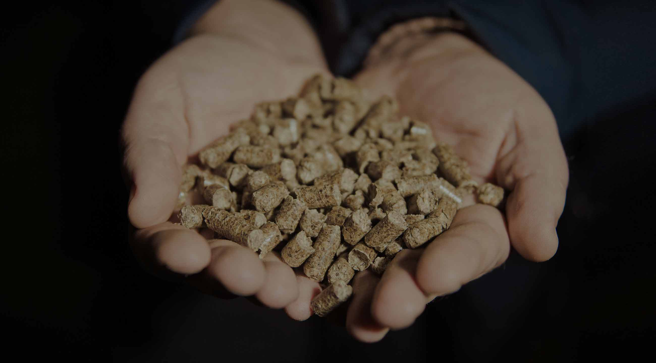

Direct Deliveries of Forest Products, Timber, and Pellets
September 2020

Slide 2
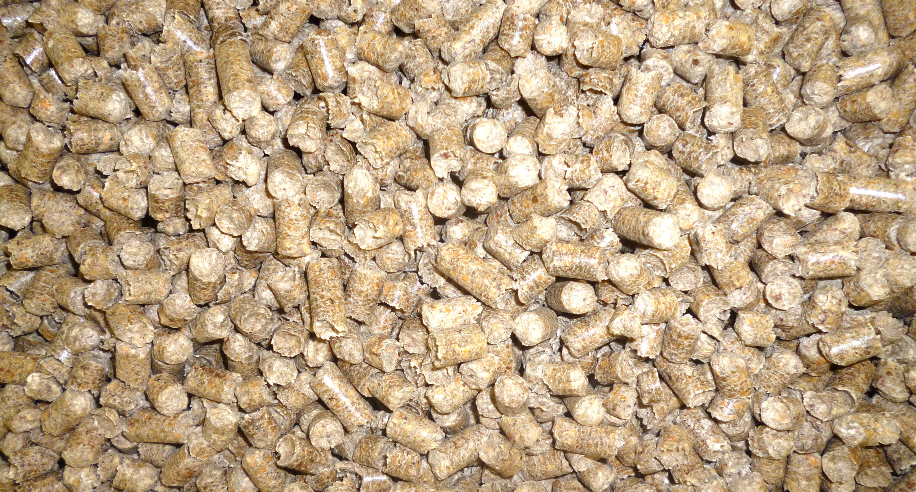

Contents:
About BioLesProm, LLC
Our Products
Environment and Social Accountability

Slide 3
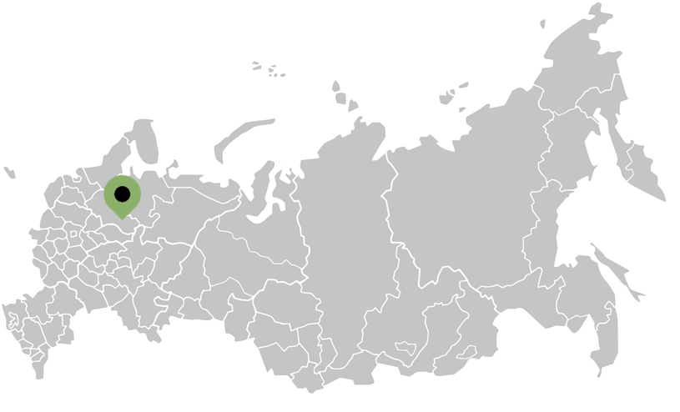
Location
BioLesProm, LLC was founded in 2008 in northwest Russia, the Vologda Region.
Our region stands at the head of constituent entities of the Russian Federation in timber resources.
The total forest area of the Vologda Region is 72% of the Region’s territory (11.7 million hectares).
The volume of timber is over 1.7 billion m³.
The permissible volume of timber in the Vologda Region is 28.9 million m³, 11.9 million m³ of which is soft wood.
The actual use of the yield from felling is 14.55 million m³, which is 50.3% of the total permissible volume.
BioLesProm

Slide 4
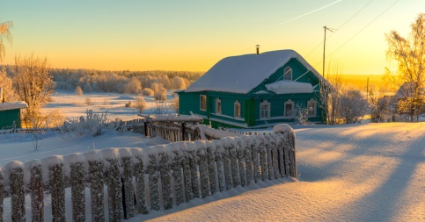
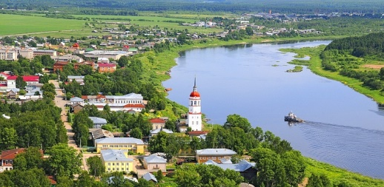
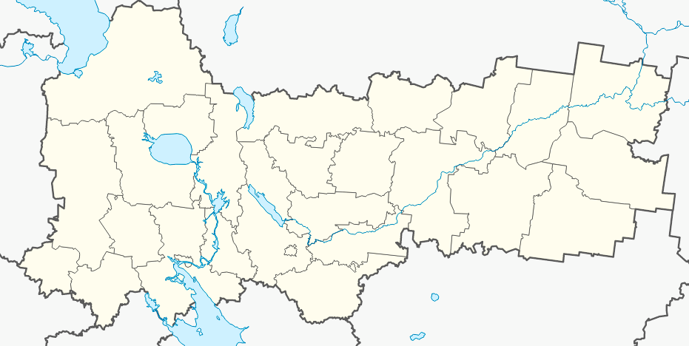

Location
In the north of the Vologda Region, to be precise...
BioLesProm, LLC is a vertically integrated company, the profile of which includes the following:
Timber Logging
Timber Production
Furniture Board Manufacture
Wood Briquette Manufacture
Wood Pellet Manufacture
350 employees are involved in the work process of BioLesProm, LLC.
BioLesProm, LLC entered into long-term Lease Agreements for timber lands. The calculated felling rate under such Agreements is 406,240 m³ per year, with the total area of 158,406 hectares. The classification of the calculated felling areas by farms shows that the calculated softwood felling is approximately equal to the hardwood felling.
Verkhovazhye
Verkhovazhye/Vologda Region/Russia

Slide 5

BioLesProm, LLC
Verkhovazhye District, Vologda Region, Russia
Timber Logging (annual volume of 400 thousand m³)
Round timber is dispatched by rail from the own railway siding located at the Velsk Severnaya Railway Station, the Arkhangelsk Region.
Average monthly dispatch by rail is up to 450 wagons of 27 thousand m³.
Contracts have been entered into with such large plants as:
International Paper, CJSC
Karjala Pulp, LLC
Volga, JSC
Vlast Truda Plywood Manufacturing Plant, JSC
Ikea Industry Tikhvin, LLC
MM-Efimovsky, LLC
ChFMK, JSC
UPM-Kymmene, LLC
Syktyvkar Plywood Manufacturing Plant, LLC
Plyterra, CJSC, and other plants in Russia and Finland

Slide 6
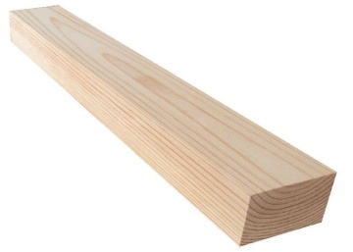
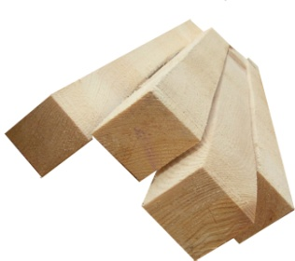
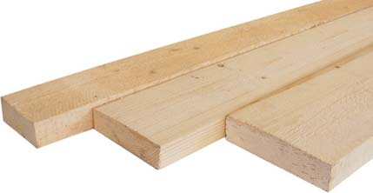
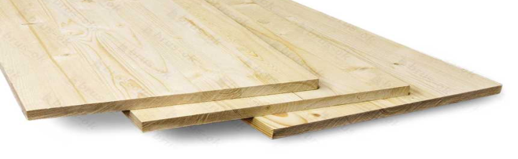
Manufacture
Sawn Wood (boards, square logs, scantlings) with the annual volume of 50 thousand m³
Furniture Board
with the annual volume of 20 thousand m³

Slide 7

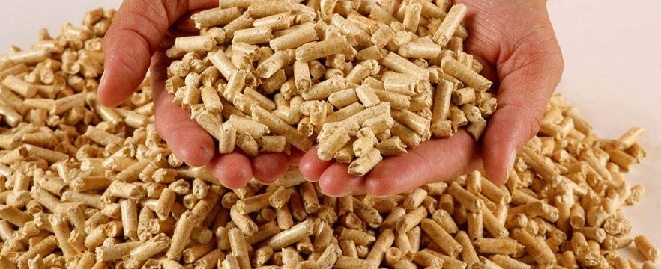
Manufacture
RUF Wood Briquettes
with the annual volume of
15 thousand tons
Wood Pellets
with the annual volume of
10 thousand tons

Slide 8






ENVIRONMENT AND SOCIAL ACCOUNTABILITY
Active and Constant Regeneration of Forest Resources
Environmental Safety of Manufacture.
No Atmospheric Emissions of Pollutants
Township-Forming Enterprise, principal taxpayer in the region
Own Social and Charitable Programs
Nominee for 100 Best Products of Russia Award
Forest Regeneration, Conservation and Protection. Liability and Legality of Forest Management

Slide 9


COOPERATION
PARTNERSHIP
Being the experts on the timber processing market, we constantly assess the investment opportunities of our region for the construction, development, and purchase of timber enterprises. We invite investments for the development of pellet production and are ready for cooperation.
SALE OF OUR PRODUCTS
We are always open to new contacts for direct deliveries of forest products, timber and pellets from Russia and strive to increase the export share of our products.

Slide 10
Goals of BioLesProm, LLC
Verkhovazhye District, Vologda Region, Russia
Entering into long-term contracts for the delivery of birch pulpwood, annual volume of 150 thousand m³.
Entering into long-term contracts for the delivery of furniture board, annual volume of 20 thousand m³.
Entering into long-term contracts for the delivery of wood briquettes, annual volume of 15 thousand tons.
Entering into long-term contracts for the delivery of wood pellets, annual volume of 10 thousand tons.

Slide 11
Contacts of BioLesProm, LLC
Verkhovazhye District, Vologda Region, Russia
Taxpayer Identification Number (INN): 3505004605, Tax Registration Reason Code (KPP): 350501001
Primary State Registration Number (OGRN): 1083537000810
Registered Office : 24, Parkovaya St., Verkhovazhye Village, 162300, Vologda Region
Correspondence Address: 24, Parkovaya St., Verkhovazhye Village, 162300, Vologda Region
Tel. 8-921-716-39-74
Yulia Sergeevna Rakovets, General Director

Slide 12
Thank you for watching

