Slide 1


Slide 2

ADVERS
Third largest heater manufacturer in the world
More than 14 years in business
Obtained more than 40 patents
More than 900 partners worldwide
Two Manufacturing facilities in Samara
more than 850 employees

Slide 3
AUTOTERM
Part of ADVERS company
Main distribution center in Europe
Warehouse located in Riga/LATVIA.
More than 6 years in business
More than 500 partners in Europe

Slide 4
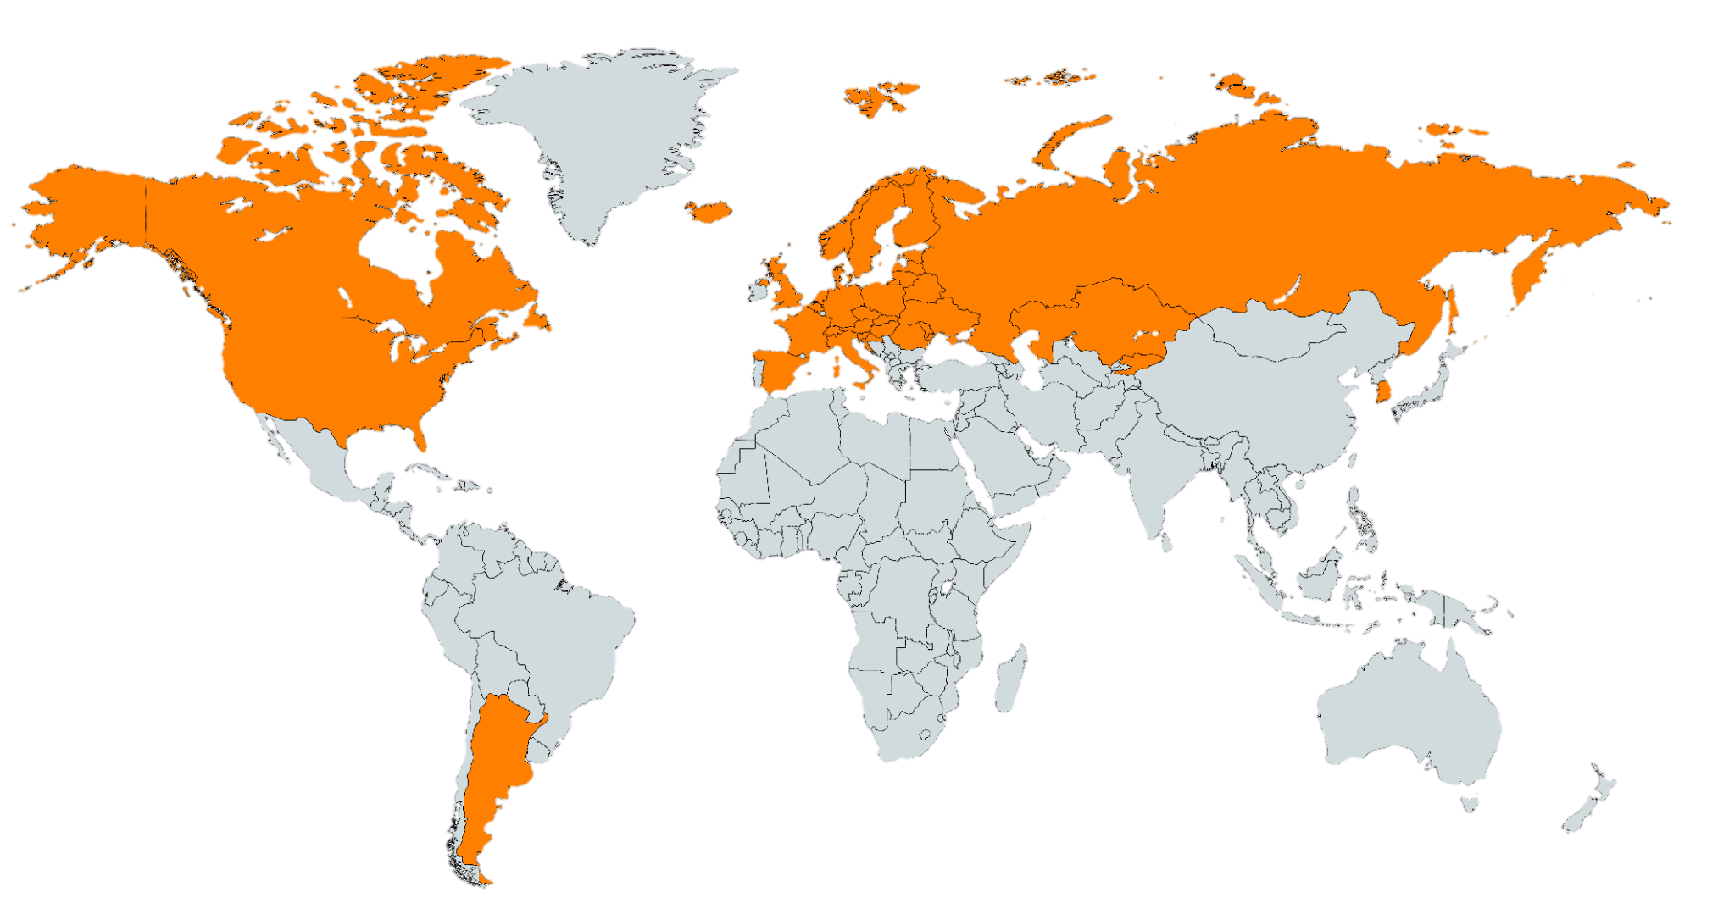
PARTNERS WORLDWIDE

Slide 5
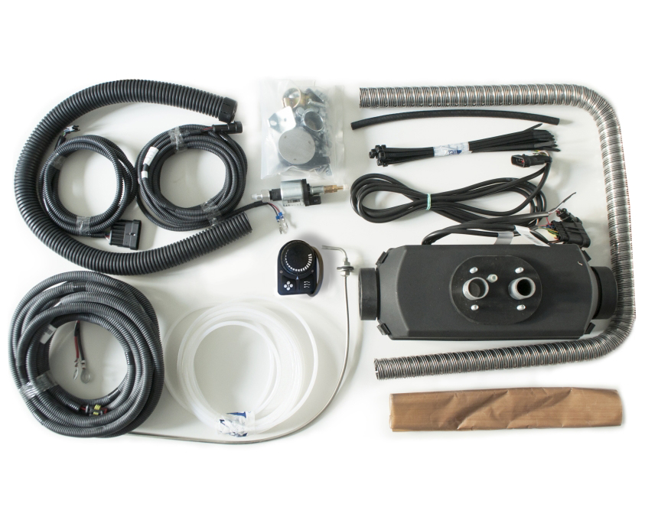
PRODUCTS
AIR HEATER PLANAR 2D, 12 or 24V 2kW (DIESEL)
All heaters come with a complete universal installation kit!
Heat power (min/max): 0,8 - 2 kW
Heated air volume, m3/h: 75
FOR HEATING:
Any kind of means of land transport
low truck cabins
commercial vehicle cabins or cargo compartments
small campers
Boats (up to 33 feet/10 m long)
Premises:
Small greenhouses
Small mountain houses

Slide 6
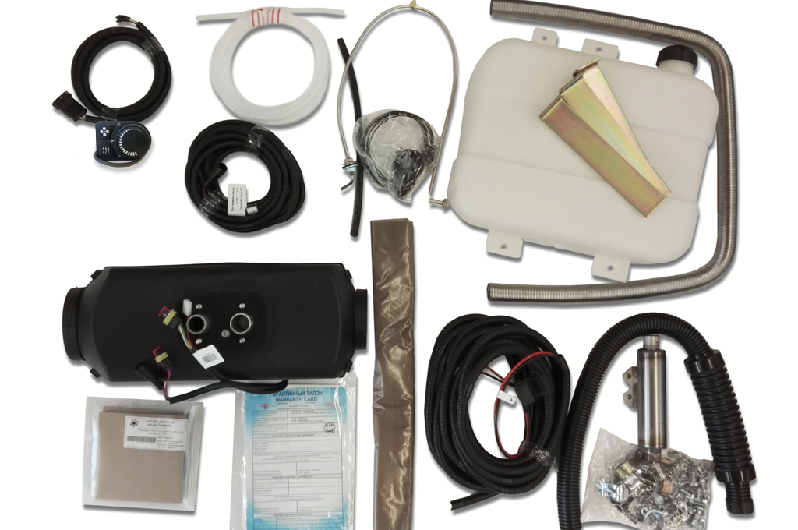
PRODUCTS
AIR HEATER PLANAR 44D, 12 or 24V 4kW (DIESEL)
All heaters come with a complete universal installation kit!
Heat power (min/max): 1 - 4 kW
Heated air volume, m3/h: 120
FOR HEATING:
Any kind of means of land transport
Middle and high size truck cabins,
Commercial vehicle cabins or cargo compartments
Campers
Boats (up to 48 feet/15 m long)
Premises:
Garages
Mountain houses
Converted shipping containers

Slide 7
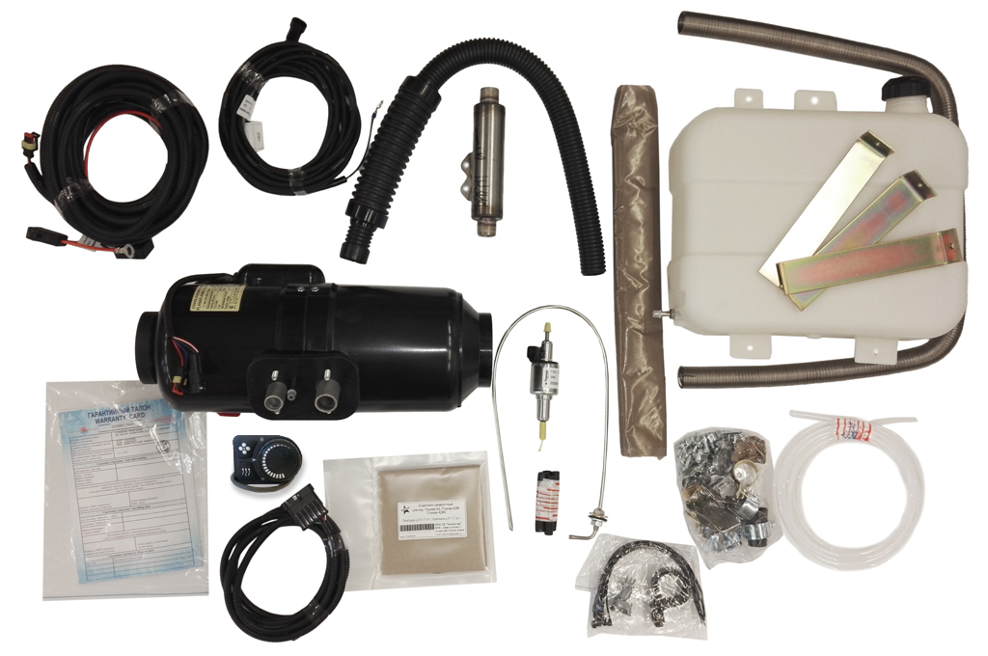
PRODUCTS
AIR HEATER PLANAR 8DM, 12 or 24V 6kW (DIESEL)
All heaters come with a complete universal installation kit!
Heat power 12V(min/max): 3.2- 6 kW
Heat power 24V(min/max): 3.2- 7.5 kW
Heated air volume, m3/h: 175
FOR HEATING:
Any kind of means of land transport
Truck and commercial vehicle cargo compartments
Busses
Small class specialty vehicles
Boats (up to 48 feet/15 m long)
Premises:
Garages
Mountain houses
Converted shipping containers

Slide 8
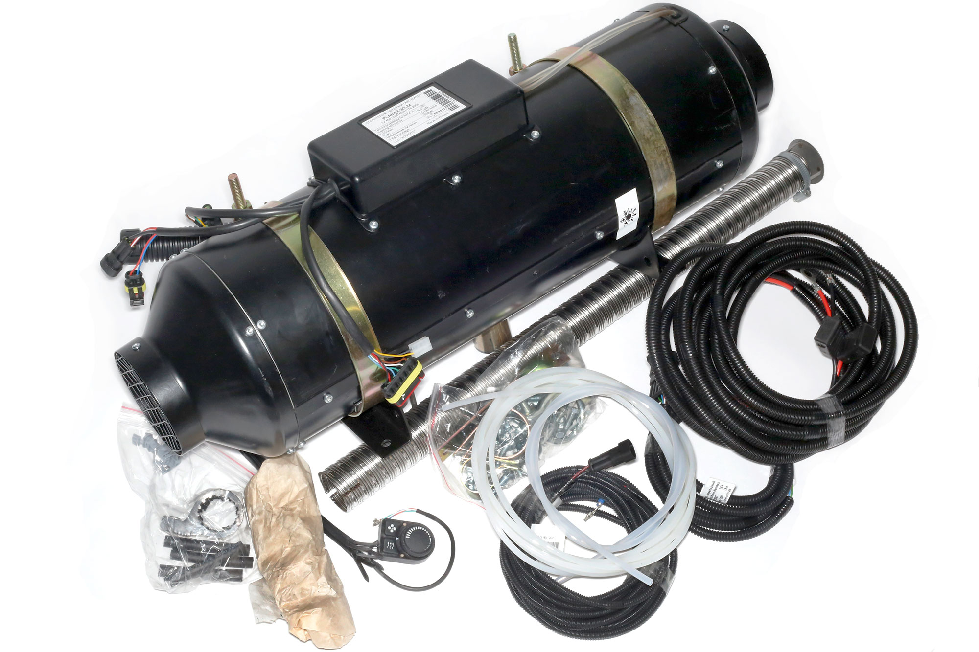
PRODUCTS
AIR HEATER PLANAR 9D, 12 or 24V 8kW (DIESEL)
All heaters come with a complete universal installation kit!
Heat power( min/ max): 3.2 - 8 kW
Heated air volume, m3/h: 290
FOR HEATING:
Any kind of means of land transport
Truck and commercial vehicle cargo compartments
Busses
Small class specialty vehicles
Boats (up to 65 feet/20 m long)
Premises:
Small warehouses
Mountain houses
Converted shipping containers

Slide 9
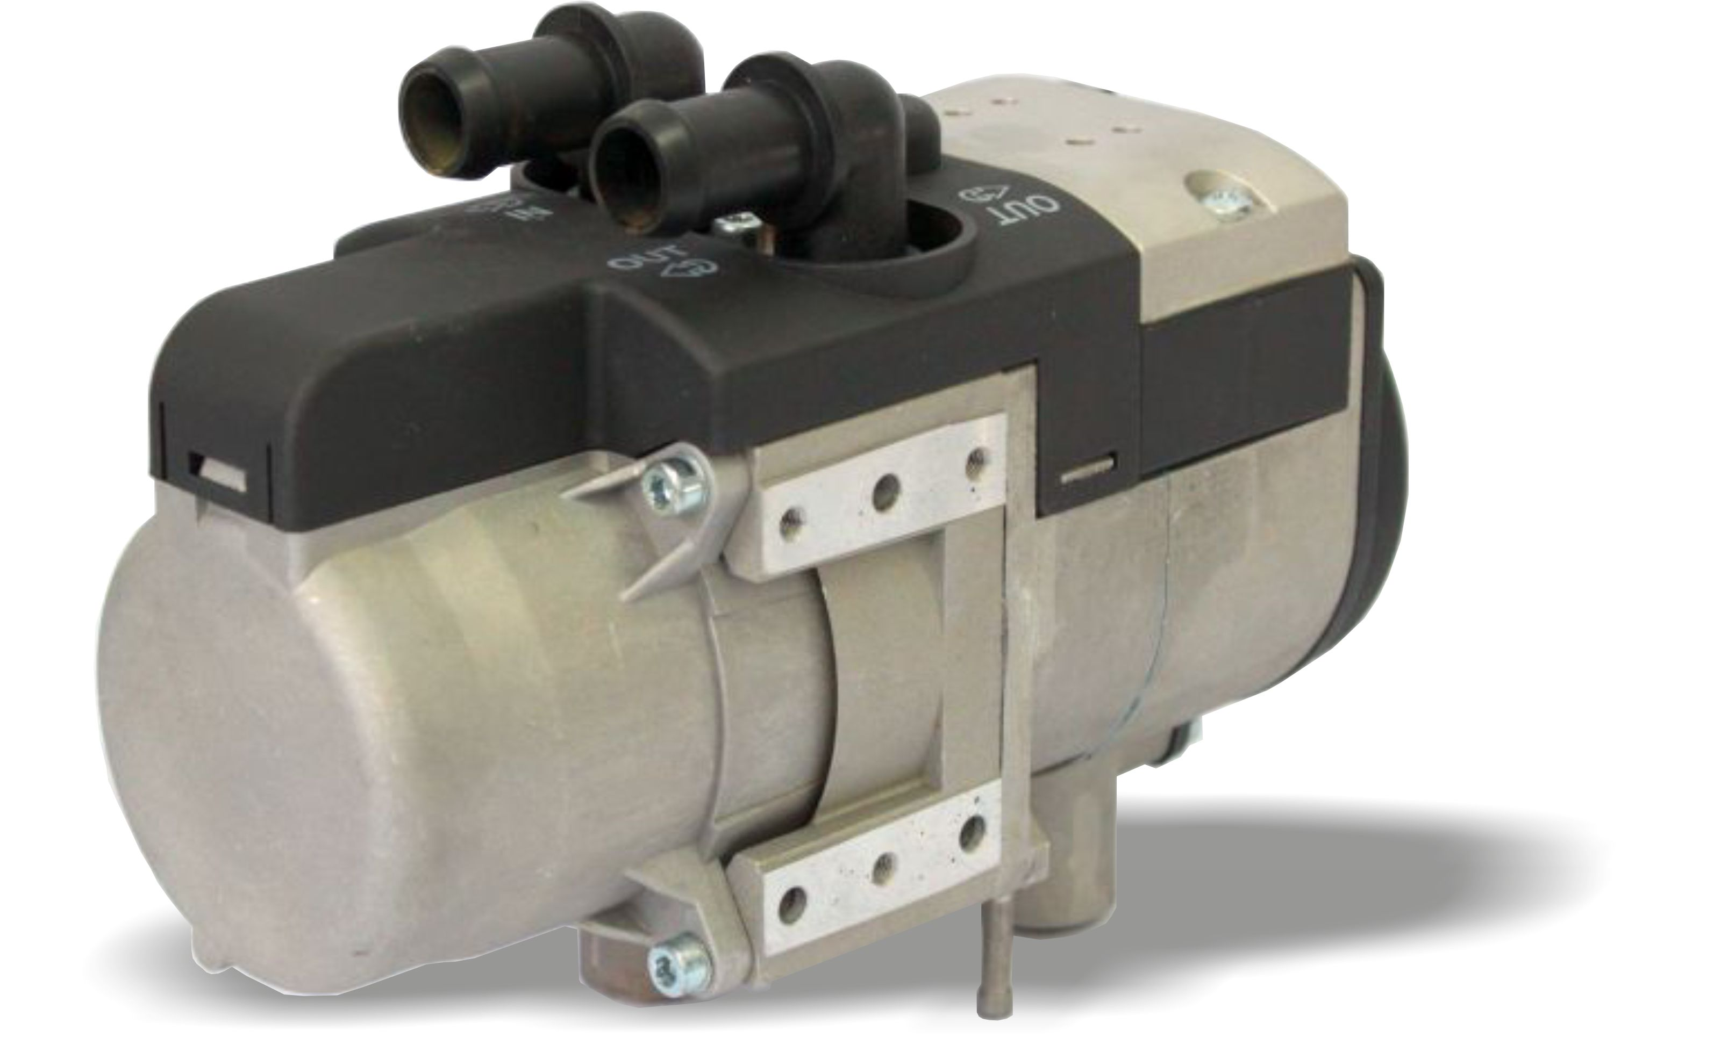
PRODUCTS
LIQUID HEATER BINAR 5S, 12 or 24V 5kW (DIESEL OR PETROL)
All heaters come with a complete universal installation kit!
Heat power: 5 kW
Optimal coolant volume: 10-12 Liters
FOR HEATING:
Can be installed in commercial trucks, cars, motor-homes, heavy equipment, school buses, boats and yachts. Pre-start engine coolant heaters work independently from engine. They heat up engine coolant to provide easy start at low temperature. At the same time they supply hot air to passenger cabin/compartment keeping it warm and dry.

Slide 10
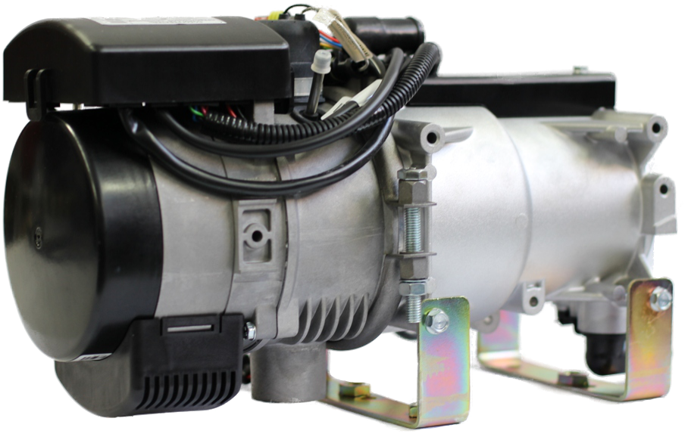
PRODUCTS
LIQUID HEATER 14TC-MINI, 12 or 24V 14kW (DIESEL)
All heaters come with a complete universal installation kit!
Heat power: 14 kW
Optimal coolant volume: 25-30 Liters
FOR HEATING:
Can be installed in commercial trucks, boats up to 50′, heavy equipment, school buses.
Pre-start engine coolant heaters work independently from engine. They heat up engine coolant to provide easy start at low temperature. At the same time they supply hot air to passenger cabin/compartment keeping it warm and dry.

Slide 11

ADVERS TECHNOLOGY
Completely closed production cycle from design to packaging
Foundry
Casting from aluminum
Casting from plastic
Stamping
Welding
Electric installation production
Manufacture of Electric Motors
Manufacture of Fuel Pumps
Mechanical production
Manufacturing of bench equipment
Tool production
Assembly
Testing
Packaging

Slide 12







ADVERS Industrial partners
14ТС-10
PLANAR 44D
PLANAR 4DM
BINAR 5 Compact
PLANAR 8DM

Slide 13
EXPORT

Slide 14



Certification
Certification and European market protection against non certified and smuggled products
Products are certified with QM system that complies with the ISO 9001:2008 and ISO/TS 16949:2009 international quality standards.
All products have undergone tests in European UTAC and TUV offices for compliance with the requirements of the UNECE 122 regulation
In 2017 obtained new quality certificate IATF 16949:2016

Slide 15
COOPERATION BETWEEN AUTOTERM AND PARTNERS
To provide continuous availability of equipment and its spare parts and accessories
To provide order processing and preparation within 1 business day
By Dealer's request, AUTOTERM's representative will attend the exhibitions and fairs organized by Dealer
SALES

Slide 16


SERVICE COOPERATION BETWEEN
AUTOTERM AND PARTNERS
Delivery planning for 3 months - guaranteed delivery of products
Provides the fastest and most economical dispatch of the shipment within 1 business day from the time of order receipt.
In accordance with the customer, delivery of special, urgent items within 36 hours of receipt of the order
LOGISTICS
Within Europe
SELLERS
ADVERS
AUTOTERM
DEALERS
CUSTOMERS
3
WEEKS
4
DAYS
2 DAYS

Slide 17
SERVICE COOPERATION BETWEEN
AUTOTERM AND PARTNERS
Providing customer technical support over the telephone 24/7
Dealers technical support by mail, Skype and telephone on weekdays from 9.00-18.00 local time, but In urgent cases, dealer consultations is 24/7
Acceptance of the Guarantee that is displayed by Dealers in 10 days
Warranty work on the Service if dealer could not find out solution
SUPPORT

Slide 18
PERSONNEL TRAINING & CERTIFICATION
Training of Dealer technical personnel in AUTOTERM Service Center, Dealer Certification
After a planned schedule, technical personnel training and certification at the dealer’s service centers by authorized training team.
By Dealer's request, technical specialist visits at Dealer’s location
CERTIFICATION

Slide 19
WE ARE
READY
PLEASE CONTACT:
Tatiana Hodgkinson
Distribution manager t.velmeseva@autoterm.ru
GSM +7 927 767 12 38 www.autoterm-europe.com
ADVERS
AUTOTERM

